Slide 1
HTML 5
The next generation of web programming

Slide 2
Where it all began

Slide 3
Where it all began
Tim Berners-Lee
CERN Scientist
We have an outlet for sharing information
The internet
No way to represent information
Have the ability to specify formatting
Embed pictures and other things.
Need some sort of standard
How to represent this formatting
How to render this standard on a display
Solution:
HTML tags

Slide 4
Where it all began CONT.
Hyper Text Mark Up Language
Basic building blocks for all web pages
First used by a physicist Tim Berners-Lee while working at CERN for sharing documents
Berners-Lee wrote first specifications and first browser for interpreting it
Project was not adapted by CERN
First specifications released informally in 1991 as “HTML Tags”
20 basic elements
13 elements still around in HTML 4
Went through many drafts before settling on HTML 2.0
November 1995
Notes:
HTML is a text and image formatting language used by web browsers to dynamically format web pages

Slide 5
Where it all began cont.
HTML 2.0 November 1995
Added
Form-based file upload
Tables (oh boy)
Client Side images maps
Internationalizations
All of these were declared obsolete/historic in June 2000
HTML 3.2 January 1997
First version that was officially released by the W3C
No more blink or marque
HTML 4.0 December 1997
Depreciated elements are forbidden

Slide 6
W3C and WHAT
Word Wide Web Consortium
Founded in October 1994
Founder: Tim Berners Lee (CERN scientist)
Set all standards for HTML
Web Hypertext Applications Technology Working Group
Founded in June 2004
Wanted to
Document HTML error handling
Improve HTML forms
Other minor changes
Without breaking compatibility
In October 2006 Berners-Lee announced W3C and WHAT would be working together to “evolve HTML”
Shortly afterwards HTML 5 was born
Released as a working draft in January 2008

Slide 7
Local Storage
Based on named key/value pairs
var foo = localStorage.getItem("bar");
// ...
localStorage.setItem("bar", foo);
5 MB local storage - QUOTA_EXCEEDED_ERR if you exceed
No browser supports for web developers to request more storage space
Everything is stored as Strings
Compatible with iPhone 2.0+ and Android 2.0+
Notes:
Calling setItem() with a named key that already exists will silently overwrite the previous value. Calling getItem() with a non-existent key will return null rather than throw an exception.
Some browsers, Opera, allow the user to control each site’s storage quota, but it is purely a user-initiated action, not something that you as a web developer can build into your web application.
If you are storing and retrieving anything other than strings, you will need to use functions like parseInt() or parseFloat() to coerce your retrieved data into the expected JavaScript datatype.

Slide 8
Offline Applications
A web application can point to a list of URLs that will be downloaded and cached locally for offline use
Changes over to local copies when offline
Uses local storage for saving state or creating data
Developer has to synchronize the information in the local storage if need be
Compatible with iPhone and Android
Notes:
A web browser that implements HTML5 offline applications will read the list of URLs from the manifest file, download the resources, cache them locally, and automatically keep the local copies up to date as they change.

Slide 9
Browser compatibility

Slide 10
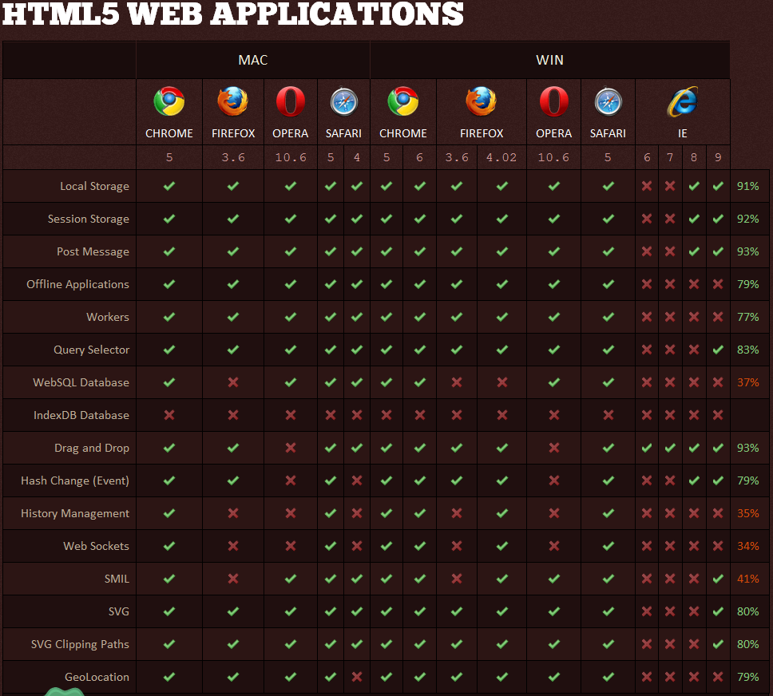
Notes:
Can obviously see that IE is lacking, this is a theme for the next 5 slides. IE 9 does become more “useable,” but is still lacking compared to other browsers.
Best: Chrome 5, 6 and Safari 5 on both mac and windows

Slide 11
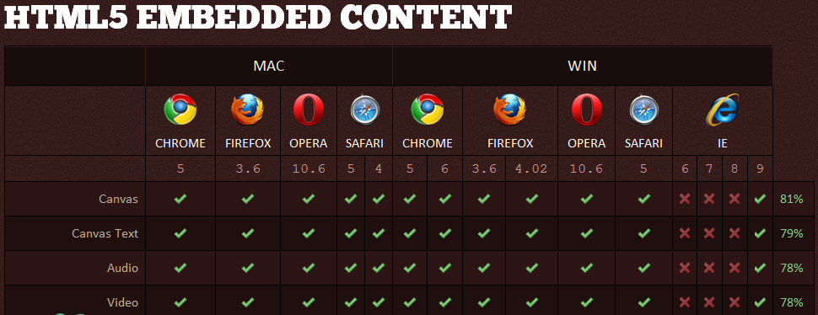
Notes:
Pretty much anything but IE 8 and less…

Slide 12
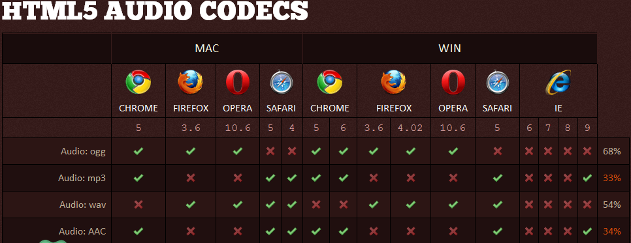
Notes:
Again Chrome and Safari tie for most compatible, but safari supports wav instead of ogg while chrome is opposite.

Slide 13
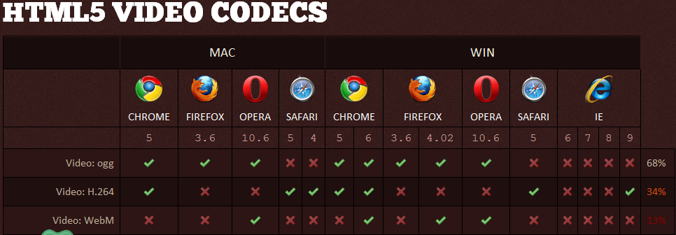
Notes:
Chrome 6 is the winner!

Slide 14
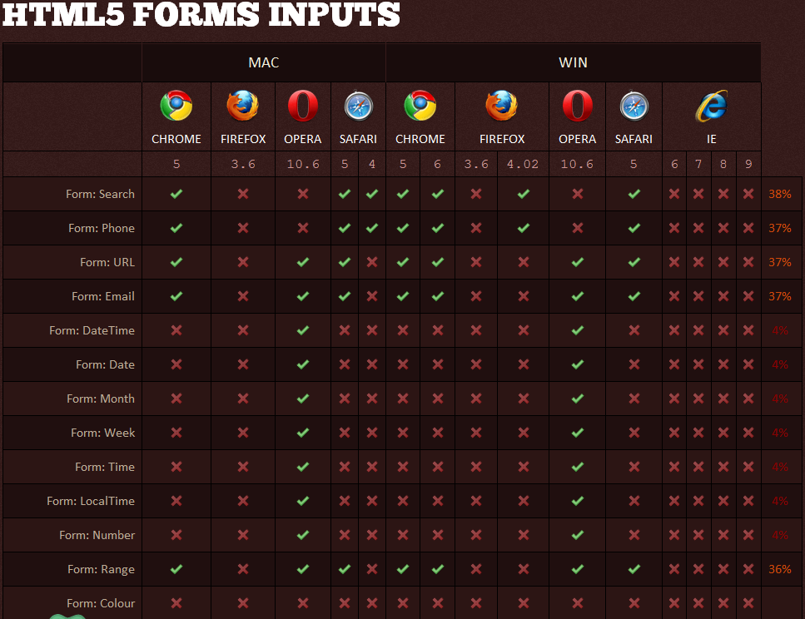
Notes:
Not too much support for HTML5 form inputs, except for opera. IE 9 isnt even expected to have any.

Slide 15
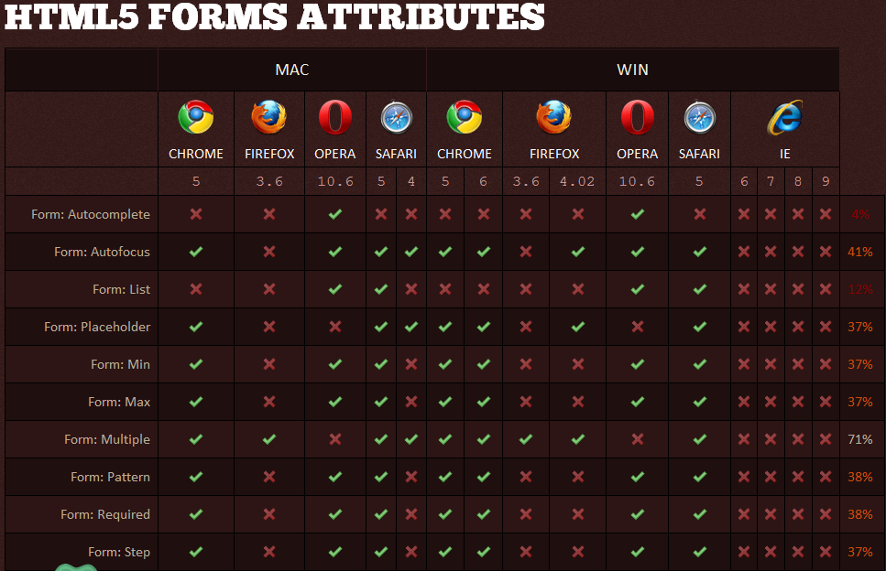
Notes:
Sarfari 5 has the most support for HTML5 form attributes, chrome and opera are close seconds. Again IE9 not supporting anything, though its still in beta.

Slide 16
Test
HTML5 Test
Notes:
Open with multiple browsers

Slide 17
DEMOs
Video
http://craftymind.com/factory/html5video/CanvasVideo.html
Drag and Drop
http://slides.html5rocks.com/#slide13
Geo-location
http://slides.html5rocks.com/#slide14
New Form Fields
http://slides.html5rocks.com/#slide21
Canvas
http://slides.html5rocks.com/#slide24
New CSS
http://slides.html5rocks.com/#slide32

